Slide 1


Chapter 7. Primitive multicellular animals
7.1 Phylum Porifera/Spongia多孔/海绵动物
7.2 Phylum Cnidaria 刺胞/腔肠动物
7.3 Phylum Ctenophora 栉水母动物

Slide 2
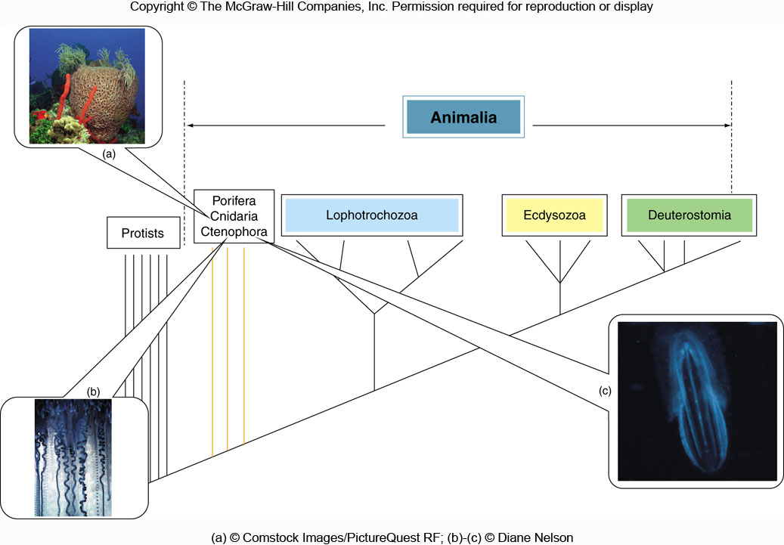
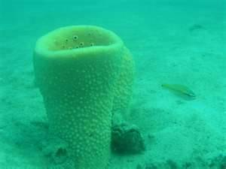
Highly Organized 严整有序的结构基础
Obtain and Use Energy 新陈代谢能力
Reproduce 繁殖能力
Grow & Develop 生长和发育
Respond to stimuli 应激性
Adapt to the Environment
Phylogenetic positions of the Porifera, Cnidaria, and Ctenophora

Slide 3
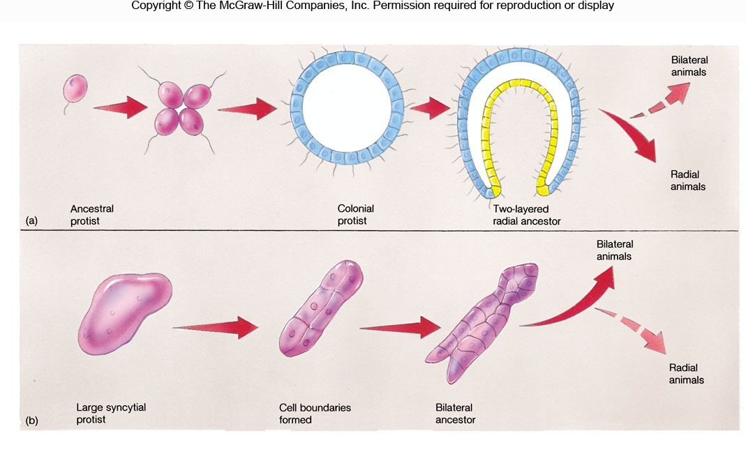
Origin of multicellularity - two hypotheses群体学说、合胞体学说

Slide 4
7.1 Phylum Porifera/Spongia
1. Evolutionary status
2. Major characteristics (key)
3. Maintenance functions
4. Reproduction
5. Classification

Slide 5
1. Evolutionary status
The most primitive, simplest multicellular animals;
An evolutionary side branch. Because of extraordinary difference compared to other multicelluar anial, sponges are also called Parazoa 侧生动物.

Slide 6
2. Major characteristics (key)
（1）Body form is non-symmetry or radial symmetry;
（2）Sessile lifestyle and canal system or water-current
system水沟系统
（3）Body is made up of three layers, including two layers
of cells: epidermis 皮层, mesohyl 中胶层,
gastrodermis胃层.
（4）Inversion in embryonic development胚胎逆转

Slide 7
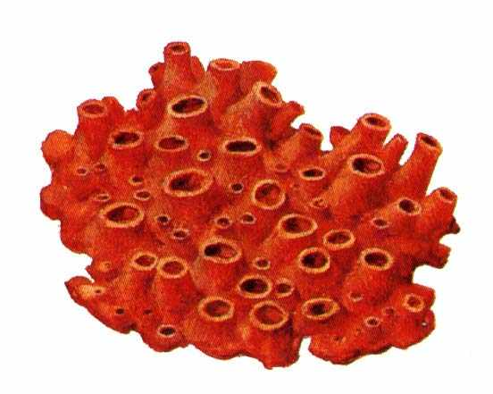
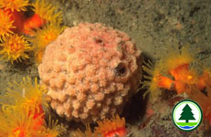
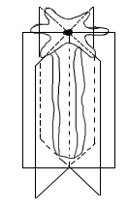
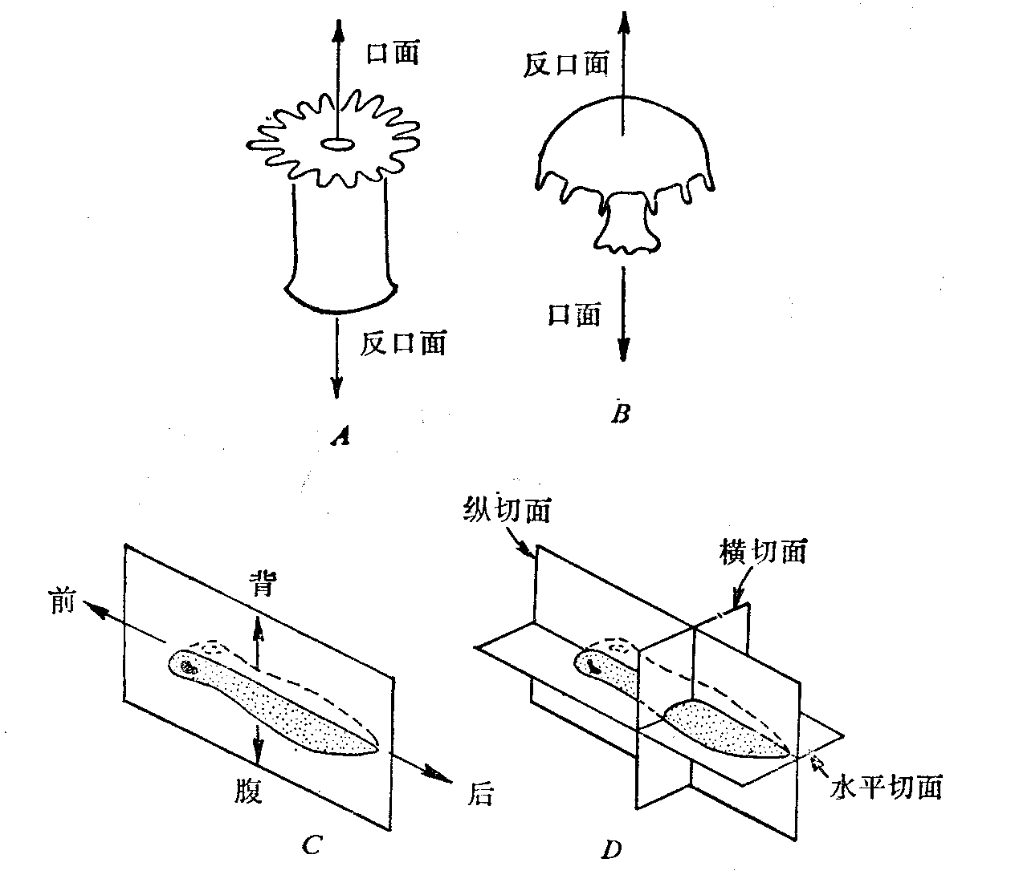
（1）Body form is non-symmetry or radial symmetry
Non-symmetry
Radial symmetry
Body can be divided into many equal parts as long as the plane of division passes through the central point of the body
Bilateral symmetry
Body can be divided into two equal halves by only a mid-sagittal plane 正中矢状面
动物体的对称类型

Slide 8
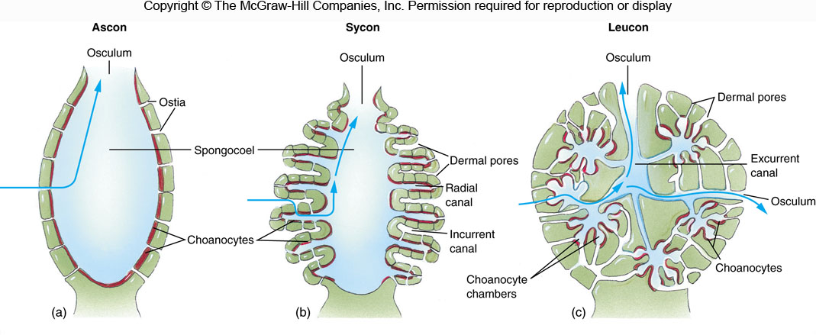
（2）Sessile lifestyle and canal system or water-current
system水沟系统
Function: Bring food and oxygen to a sponge; and carrying away digestive and metabolic wastes.
Structure: Ascon, Sycon, Leucon

Slide 9
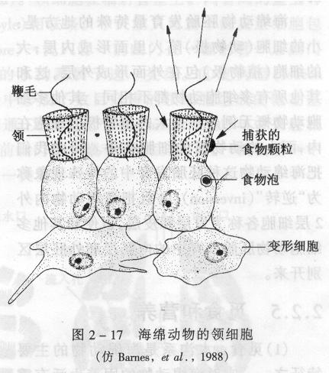
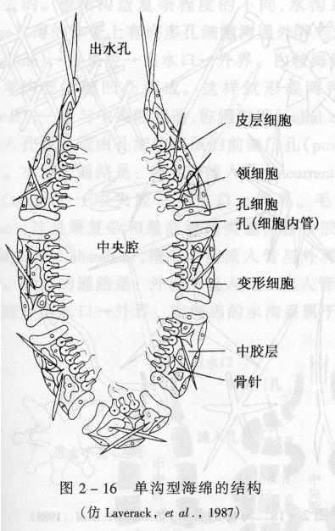
Bodies made up of 3 layers
⎯⎯ Division of labor occurs only at cellular level, without tissues or organs
• the outer layer ⎯⎯ epidermis 皮层
• the mesohyl 中胶层
• the inner layer ⎯⎯ gastrodermis 胃层

Slide 10
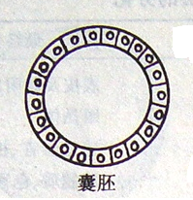
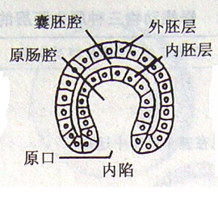
• Blastula
• Gastrulae
Diploblastic organization, the simplest tissue-level organization
Epidermis: derived from ectoderm
Gastrodermis: derived from endoderm

Slide 11
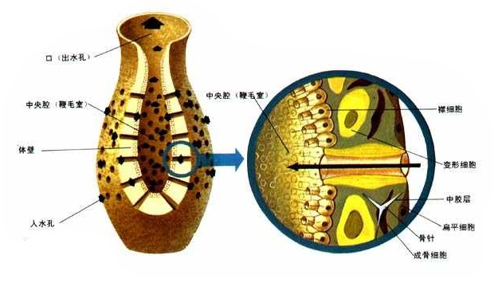
The outer layer ⎯⎯ epidermis 皮层
⎯⎯ consisting of single layer cells
single-layer pinacocyte 单层扁平细胞 + porocytes 孔细胞
Porocyte: short tube-like, located among pinacocytes
⎯⎯ Phylum Porifera 多孔动物门

Slide 12
Mesohyl 中胶层
jellylike matter + amoeboid cells 变形细胞 + spicules 骨针
Jellylike matter
Amoeboid cell
• specialized for reproduction
• secreting skeletal elements
• transporting and storing food
• forming contractile rings around openings in the sponge wall
Spicules, secreted by amoeboid cells
• Calcium carbonate 碳酸钙
• Siliceous硅酸
• Spongin 海绵硬蛋白: a fibrous protein
⎯⎯ Diverse in morphology, used as taxonomic indicators
In some sponges, spike-like structures inside the mesohyl for support, also called skeleton

Slide 13
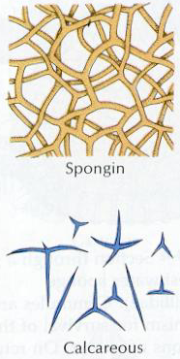
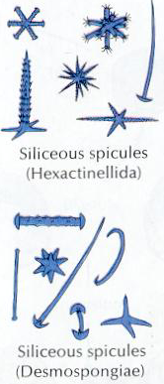

Slide 14
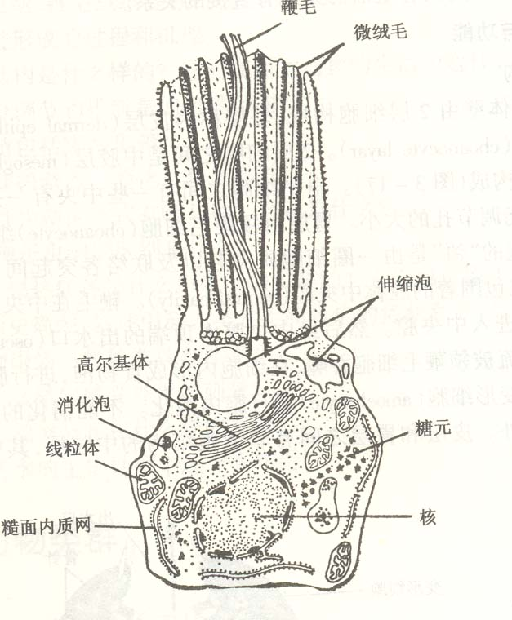
The inner layer ⎯⎯ gastrodermis 胃层
⎯⎯ consisting of single layer cells, collar cells
⎯ The flagellum creates water currents through the sponge
⎯ The collar filters microscopic food particles from the water

Slide 15
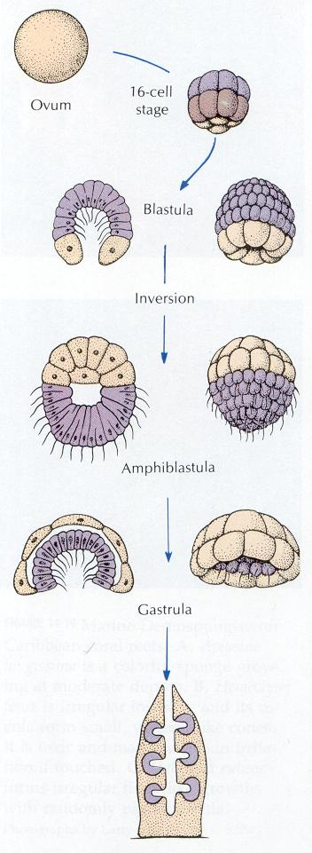
（4）Inversion in embryonic development胚胎逆转
两囊幼虫
中文教材p60
胚胎逆转：其他多细胞动物都是植物级大胚泡形成内层，
而动物极小胚泡形成外层细胞，而海绵动物正好相反。

Slide 16
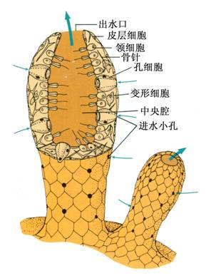
3. Maintenance functions
(1) Digestion
⎯⎯ no digestive cavity, only intracellular digestion
⎯⎯ Collar cells trap small food particles and form food vacuole
Food particles: brought into spongocoel 海绵腔 by circulating water
⎯⎯ Partially digested food is passed to amoeboid cells, which distribute it to other cells
(2) Diet
• Bacteria
• Protists
• Microscopic algae 小型海藻
• Planktons

Slide 17
(3) Circulation, respiration and excretion
⎯⎯ each individual cell functions independently，diffusion along with water through sponges.
(4) No nerve cells
⎯⎯ the response to a stimulus is transmitted from a cell to another cell

Slide 18
4. Reproduction
(1) Asexual reproduction
Budding:
⎯⎯ Some cells within mesohyl aggregate to form a gemmule 芽体, in which there are masses of amoeboid cells；
⎯⎯ When favorable conditions return, the amoedoid cells come out to develop into a new individual

Slide 19
（2）Sexual reproduction
Most monoecious 雌雄同体
• Sperm: derived from certain cells in the mesohyl that undergo meiosis; from collar cells in some cases
• Egg: derived from certain cells in the mesohyl that undergo meiosis; from collar cells in some cases
Fertilization
⎯⎯ sperm move in sea water into other sponges and are trapped by choanocytes 内皮细胞 and incorporated into the mesohyl to fertilize the egg

Slide 20
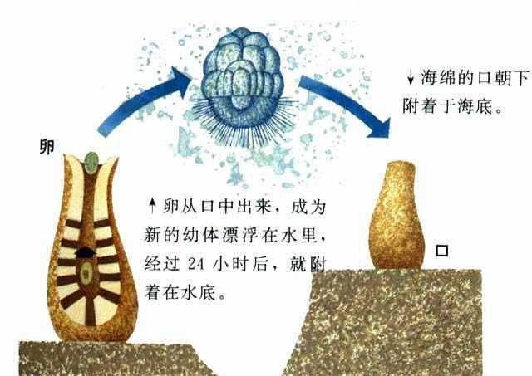
Fertilization
↓
Zygote
↓
Larva, with flagellates
↓
Adult

Slide 21
Habitats and lifestyles
Most: marine
Some: freshwater
Larva: free living
Adult: sessile living
⎯⎯ attached to rocks, mollusk shells, aquatic plants

Slide 22
Question
Which aspect of body structures in sponges may reflect adaptation to sessile living?
1．Radial symmetry
2．Canal system
3．Lacking nerve system
Therefore, they seldom experience varying environments
⎯⎯ remaining many primitive characteristics

Slide 23
5. Classification of the porifera
9000 species，three classes
1) Class Calcarea 钙质海绵纲
2) Class Hexactinellida 六放海绵纲
3) Demospongiae 寻常海绵纲

Slide 24
1. Class Calcarea 钙质海绵纲
Calcareous spicules 钙质
Ascon, sycon or leucon body forms
All marine
白枝海绵、毛壶
2. Class Hexactinellida 六放海绵纲
Siliceous spicules 硅质
Ascon, sycon or leucon body forms
All marine
偕老同穴，佛子介
3. Demospongiae 寻常海绵纲
Siliceous spicules or spongin 海绵丝
Leucon body form
Marine or freshwater
穿贝海绵、淡水海绵

Slide 25
海绵动物生物学特征总结
●体制不对称、辐射对称
●没有组织分化
●身体由皮层、胃层两层细胞构成
皮层：单层扁平细胞；胃层：领鞭毛细胞
●具有独特的水沟系统
●没有神经细胞
●胚胎发育有逆转现象
●固着生活在水中物体上

Slide 26
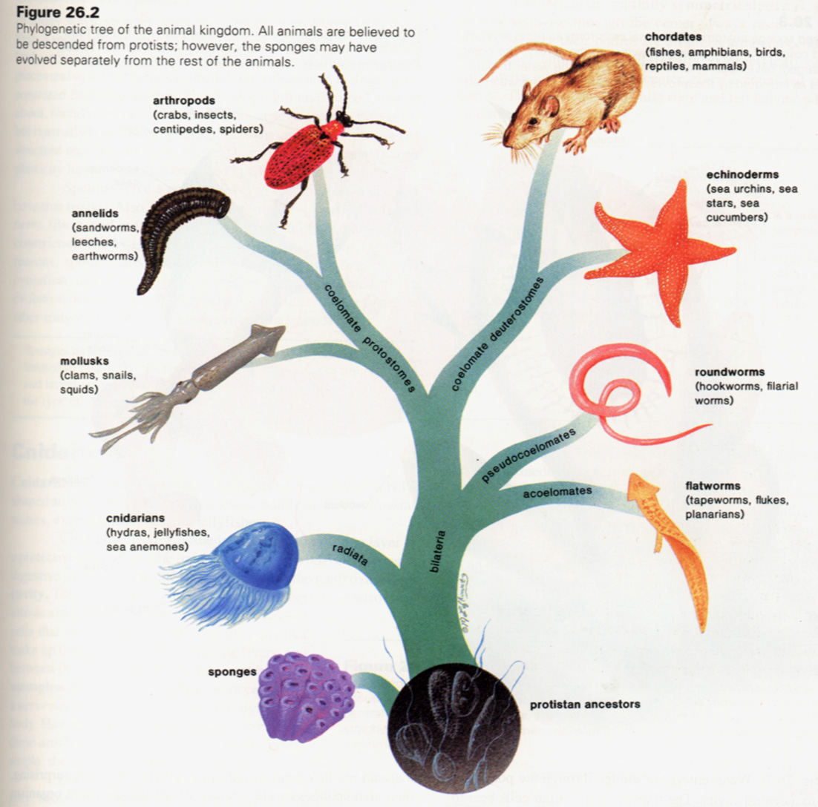
7.2 Phylum Cnidaria

Slide 27
Major characteristics
1．Radial symmetry or modified as biradial symmetry 两侧辐射对称 ⎯ the primitive symmetrical pattern
Most cnidarians possess two body forms in their life history
Polyp 水螅型 ⎯ usually asexual, sessile
Medusa 水母型 ⎯ dioecious 雌雄异体 , free-swimming

Slide 28
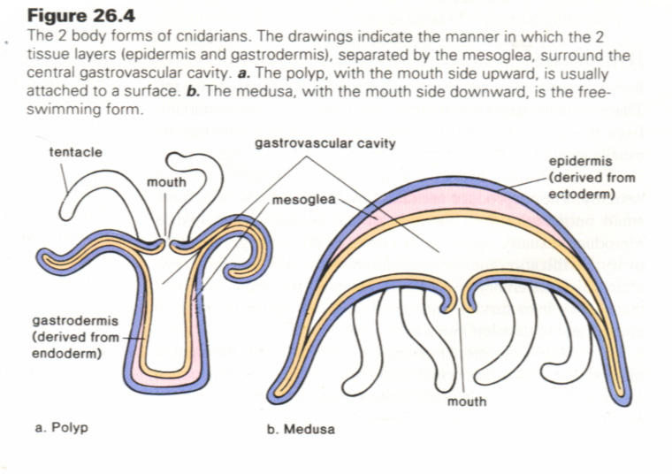
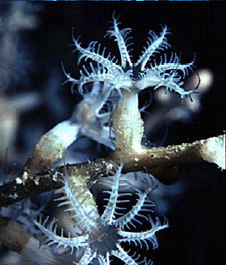
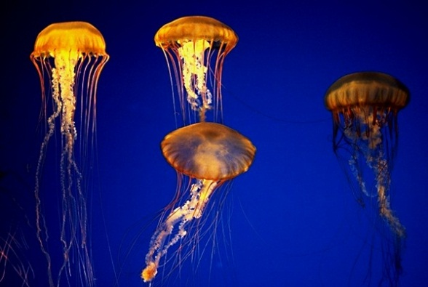
消化循环腔
触手内部的空腔与消化循环腔相通

Slide 29
2. Diploblastic, the simplest tissue-level organization
Bodies make up 3 layers
⎯⎯ Cells differentiate and organize into tissues that carry out specific functions
All cells derived from two embryological layers
• The ectoderm gives rise to an outer layer of the body wall
epidermis 皮层
• A jellylike layer between the epidermis and gastrodermis
mesoglea 中胶层
• The endoderm gives rise to an inner layer of the body wall
gastrodermis 胃层

Slide 30
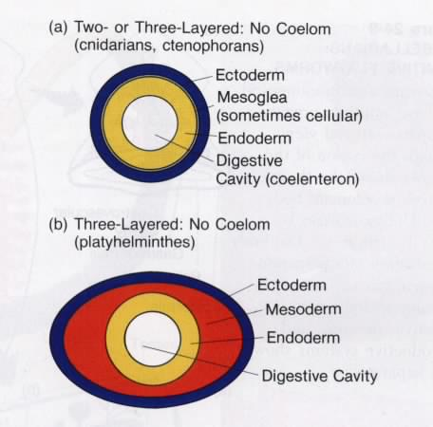
• the outer layer ⎯⎯ epidermis 皮层
• the mesohyl 中胶层
• the inner layer ⎯⎯ gastrodermis 胃层
Gastrula 原肠胚
• ectoderm 外胚层
• endoderm 内胚层
• gastrula cavity 原肠腔
⎯⎯ embraced by endoderm 内胚层
• blastopore 胚孔
⎯⎯ opening to surroundings

Slide 31
Cells in the body wall and their functions
Epitheliomuscular cell 外皮肌细胞 ⎯ contractile
protection, locomotion
⎯ with lognitudinally oriented contractile fibers that cause cell to move
Cnidocytes 刺细胞 ⎯ characteristic of the phylum
abundant in tentacles
defense, feeding and attachment
Sensory cell ⎯ distributed throughout the body
Nerve cell ⎯ located below the epidermis, near the mesoglea, and interconnect to form a nerve net
Interstitial cell 间细胞 ⎯ small in size, give rise to epitheliomuscular cells, cnidocytes and germ cells

Slide 32
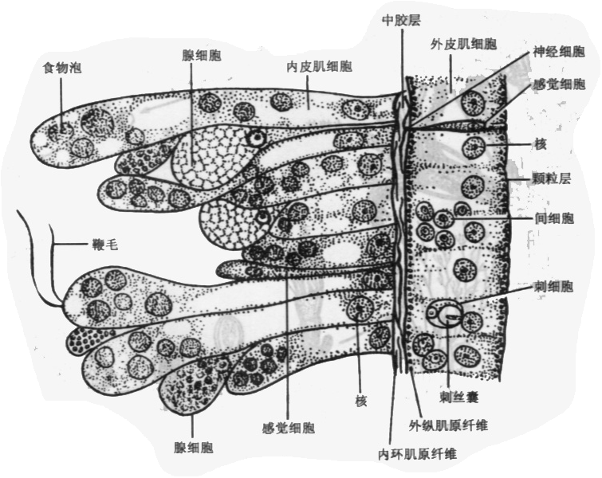
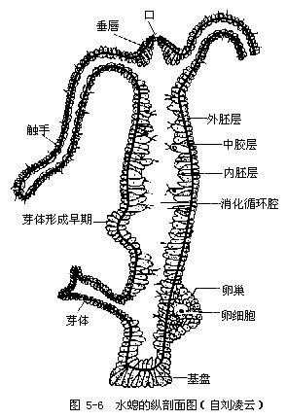
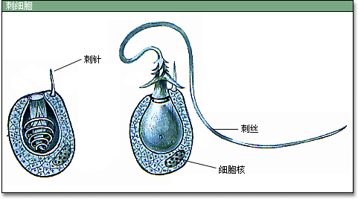
刺丝囊
水螅的刺细胞

Slide 33
Mesoglea 中胶层
Cells are present in the mesoglea of some cnidarians, but they have their origin in either the epidermis or the gastrodermis

Slide 34
Cells in gastrodermis 胃层
Nutritivemuscular cell 内皮肌细胞
⎯ swallow the partially digested food and incorporate it into food vacuoles
⎯ with circularly oriented contractile fibers that help move materials into or out of the gastrovascular cavity
Gland cell 腺细胞
⎯ secrete lubricating mucus 润滑液 and enzymes
extracellular digestion 细胞外消化
Sensory cell
Interstitial cell 间细胞

Slide 36

Maintenance functions
1. Gastrovascular cavity 原始消化循环腔
⎯⎯ a blind end, derived from the gastrocoele 原肠腔 of an embryo
Digestion
Extracellular 细胞外消化
Digestive enzyme secreted by gland cells in the gastrodermis
Circulation
• Transport of digested nutrition 消化后的营养物质送到身体各部
• Exchange of respiratory gas
• Emission of metabolic waste
• Discharge of gametes

Slide 37
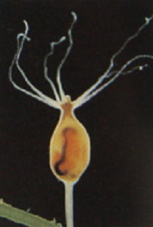
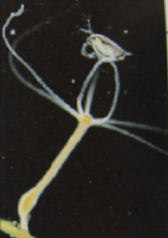
Feeding behavior of a hydra
A common freshwater hydra that hangs from the underside of floating plants in clean streams and ponds

Slide 38
2. respiration, excretion
⎯⎯ No cells are specialized to carry out the functions
⎯⎯ Each cell exchange respiratory gas and metabolic wastes with surrounding environments
Metabolic wastes: NH3

Slide 39
3. Net nervous system 网状神经系统
⎯⎯ the most primitive nervous system
• Structure
⎯⎯ bi-polar or multi-polar nerve cells link together to form a nervous network
Sensory cells: located in the epidermis, receive stimulus
Nerve cells: located in the mesoglea, near the epidermis, conduct the nerve impulse
⎯⎯ causing contraction of epitheliomuscular cells
• Functional property
⎯⎯ the nerve impulse conducts slowly, because of no central nervous system

Slide 40
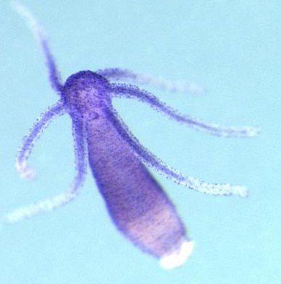
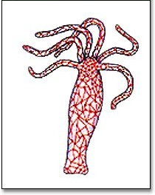
水螅的神经网

Slide 41
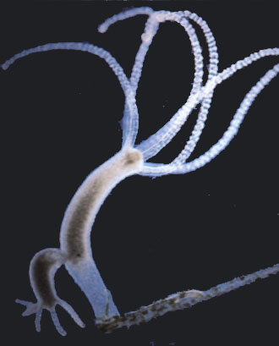
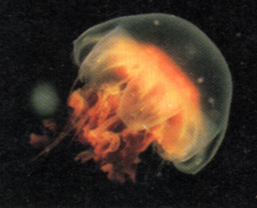
4. Reproduction
• Asexual reproduction
budding
A polyp may form other polyps by budding
Medusas nearly always form by budding from the body wall of a polyp
• Sexual reproduction
Most: hermaphroditic雌雄异体
a few: dioecious 雌雄同体

Slide 42
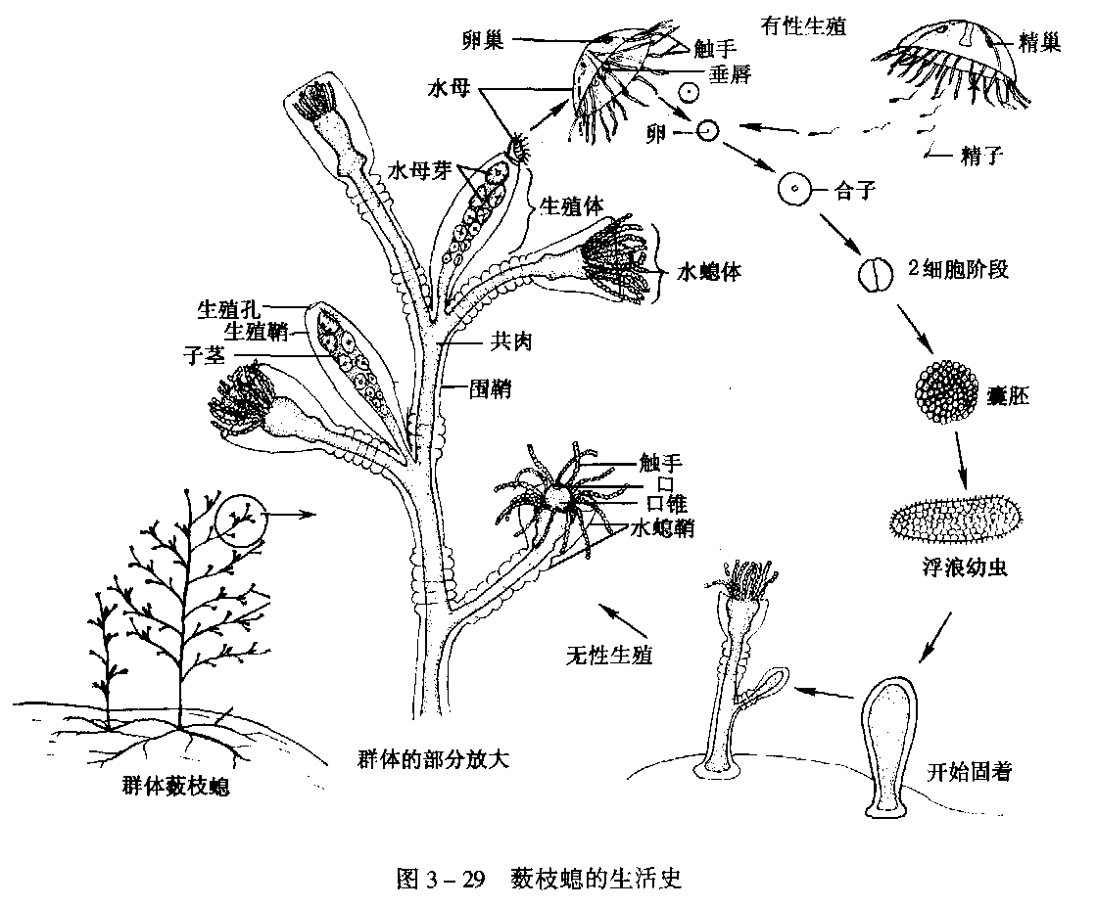
Alternation of generation 世代交替
A cnidarians life cycle involves both polyp with asexual reproduction and medusa with sexual reproduction

Slide 43
Alternation of generations 世代交替
• Asexual generation ⎯ Polyps produce medusas by budding
• Sexual generation ⎯ Medusas grow and give rise to sperms and eggs
Germ cells come from interstitial cells 间质细胞
Zygotes develop to the blastula stage 囊胚, and form a ciliary, free-swimming larva, planula 浮浪幼虫
indirect development

Slide 44
Lifestyle
• Sessile, floating
• Marine, freshwater
• No species that are parasitic
Most species: two kinds of body form
Some species: only polyp, 珊瑚纲
Some species: only medusa

Slide 45
Classification of the Cnidaria
Over 9000 species, four classes
• Class Hydrozoa 水螅纲
• Class Scyphozoa 钵水母纲
• Class Cubozoa 立方水母纲
• Class Anthozoa 珊瑚纲

Slide 46
1．Class Hydrozoa 水螅纲
• Mostly marine, some freshwater
• Most species display alternation of generations
Some: medusa stage is lost
Others: polyp state is very small
• Cnidocytes present in the epidermis
• Gametes are produced epidermally and released to the outside of the body rather than into the gastrovascular cavity
• The mesoglea is largely acellular 非细胞的

Slide 47
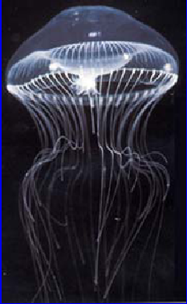
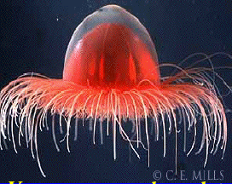
2．Class Scyphozoa 钵水母纲
• All marine
• Medusa as the dominant stage of life history
• Lacking skeleton
• Cnidocytes occur both in epidermis and gastrodermis
• Gametes are gastrodermal in origin

Slide 48
3．Class Cubozoa 立方水母纲
• Medusa: prominent in life history
• Gametes: gastrodermal in origin
• All marine

Slide 49
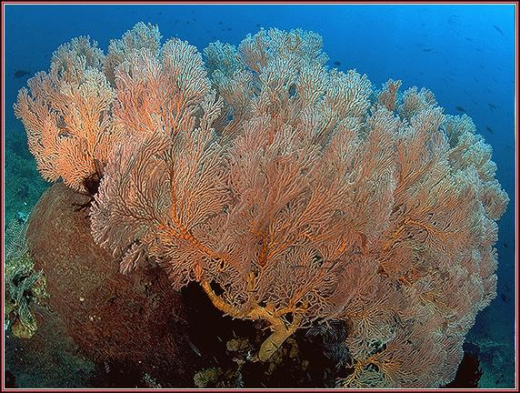
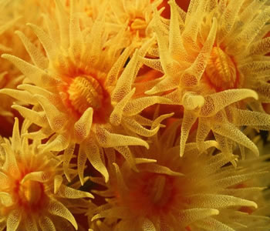
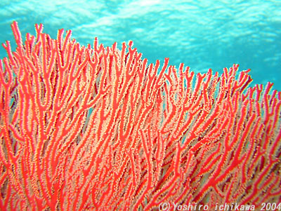
4．Class Anthozoa 珊瑚虫纲
• Only polyp, medusae absent
• Cnidocytes 刺细胞 lack cnidocil 刺针
• Gametes gastrodermal in origin
• Mesoglea contains amoeboid mesenchyme cells 间细胞
• Gastrovascular cavity divided by mesenteries 肠系膜 that bear nematocysts 刺丝囊
• All marine

Slide 50
7.3 Phylum Ctenophora
Major characteristics
1) Diploblastic or possibly triploblastic, tissue-level organizations;
2) Biradial symmetry;
3) Gelatinous胶状的, cellular mesoglea btween the epidermal and gastrodermal tissue layers;
4) True muscle cells develop within the mesoglea;
5) Gastrovascular cavity

Slide 51
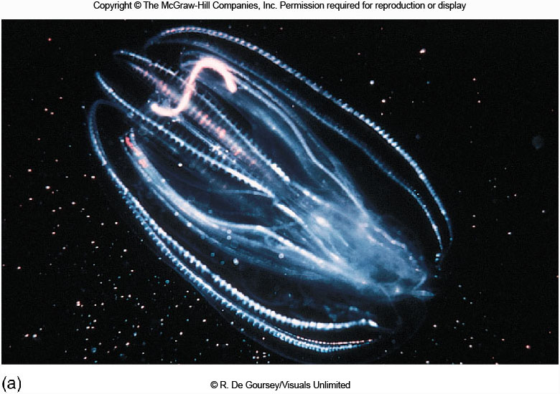
6) Nervous system in the form of a nerve net
7) Adhesive structures called colloblasts黏细胞
8) Eight rows of ciliary bands, called comb rows, for locomotion.
9) free living (floating) lifestyle

Slide 52
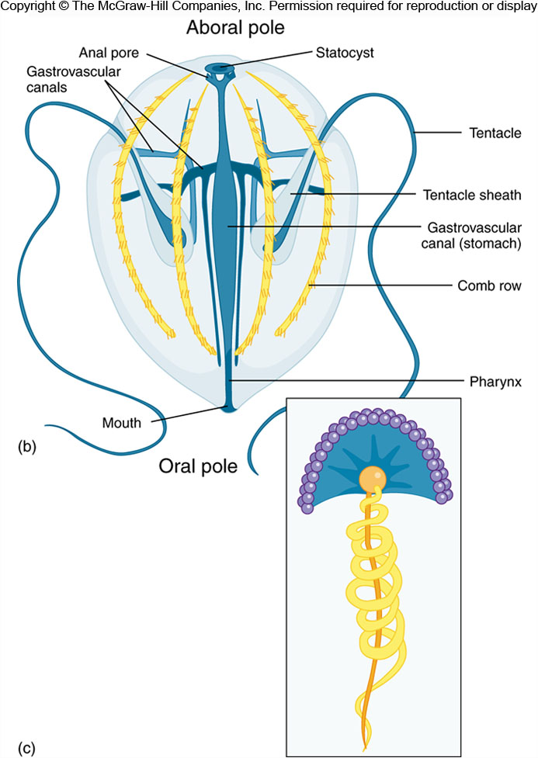
对口孔
平衡囊
Structure of a ctenophore
栉板
咽
Colloblasts of a ctenophore

Slide 53


